Slide 1

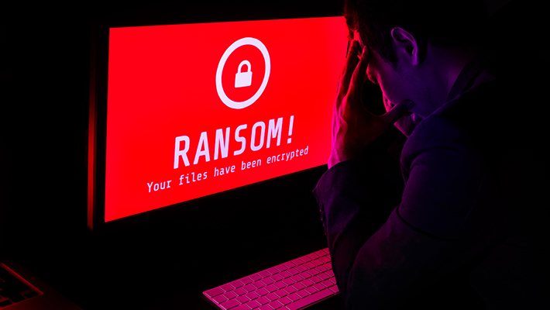
RANSOMWARE ATTACK
M. Sathvika LA3
V. Vaishanvi L59
S. Prashamsa L69
T. Adhilaxmi L79
J. Srivarsha L99
P. Spandhana 1791

Slide 2
What is Ransomware Attack:
is a type of malware attack in which the attacker locks and encrypts the victim’s data, important files and then demands a ransom (payment) to unlock and decrypt the data.
A ransomware attack is a type of cybercrime where attackers use malware to encrypt a victim's files or lock them out of their systems, effectively holding the data hostage. The attackers then demand a ransom from the victim, usually in cryptocurrency, to restore access to the locked data or system.

Slide 3
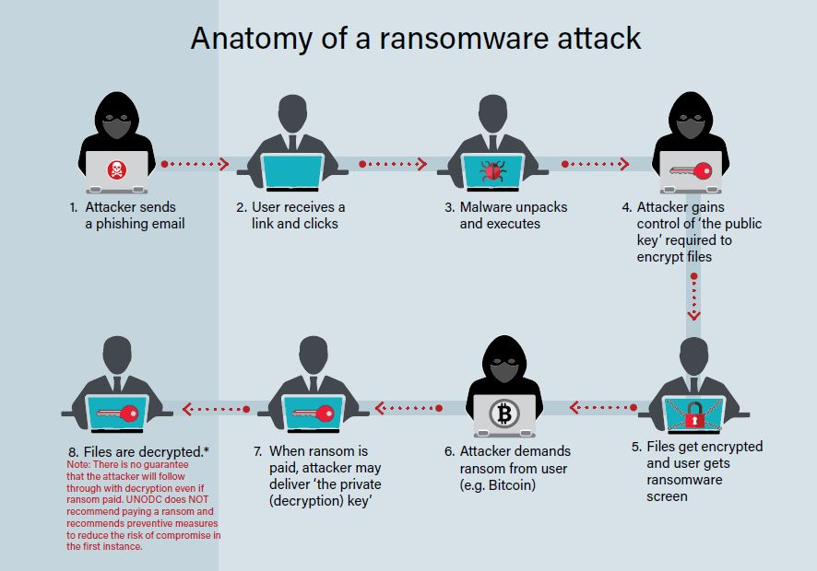
How does it works:
Encryption: The malware encrypts the files on the infected system, making them inaccessible to the victim.
Ransom Demand: The attackers demand a ransom in exchange for the decryption key or to unlock the system.
Double-Extortion: Some attackers threaten to release or sell the victim's data if the ransom is not paid.
Methods of Infection: Common methods include phishing emails, malicious websites, and exploiting vulnerabilities in software.
Impact: Ransomware can cause significant financial loss, operational disruption, and damage to reputation.

Slide 4
Impact of the attack:
Financial Loss: Organizations may face direct financial losses due to the ransom payment, costs associated with incident response, system restoration, and potential legal fees.
Data Loss: In some cases, even if the ransom is paid, there is no guarantee that the attackers will provide a decryption key. This can result in permanent data loss, requiring the organization to rebuild or regenerate the information
Legal and Compliance Issues: Organizations may face legal consequences if sensitive data, such as personal information, is compromised. This can lead to regulatory fines and increased scrutiny from authorities.
Intellectual Property Theft: If trade secrets or proprietary information is stolen, it can result in a loss of competitive advantage and potential legal action.
Increased Cybersecurity Costs: After an attack, organizations often need to invest in enhanced cybersecurity measures, employee training, and regular vulnerability assessments to prevent future incidents.

Slide 5
How to prevent the attack:
Regular Backups: Frequently back up important data and ensure that backups are stored offline or in a separate network. This way, even if your system is compromised, you can restore your data from backups.
Update and Patch Systems: Keep your operating systems, software, and applications up to date with the latest security patches. This helps close vulnerabilities that attackers might exploit.
Educate Employees: Conduct regular cybersecurity training for employees to help them recognize phishing attempts, malicious links, and other social engineering tactics.
Email Security: Use email filtering and anti-phishing tools to block suspicious emails and attachments before they reach your inbox.
Access Controls: Limit user access to only the data and systems necessary for their roles. Implement the principle of least privilege to reduce the risk of unauthorized access.

Slide 6
THANKYOU

